Slide 1
ENPM 665 Cloud Security
Webapp project

Slide 2
Architecture
Component | Description
Region | AWS us-east
VPC | Single VPC with Public subnet, two Private Subnets
AuthN | SSO and MFA on web application
IAM | Users stored in AD instance
TLS | Enabled for all service endpoints
DBMS | AWS RDS
IAC | Terraform or Cloud Formation
Compliance | Capture security compliance criteria.

Slide 3
Use Case
Web Application Deployed to Public Subnet
Web Service 1 Deployed to Private Subnet 1
Web Service 2 Deployed to Private Subnet 2
Web Application Authenticates users via UNP/MFA/TLS
Web Application Provides Link to Invoke Web Service 1 using TLS
Web Service 1 calls Web Service 2 hosted on Private Subnet 2
Web Service 2 calls RDS to query data for End-User
Data Returned to Web Application and Rendered on Web Page

Slide 4
Demo
Demonstrate Authentication via UNP/MFA/TLS for Each Users into Web Application
Display Response Data is Different for Each User
Show Audit Logs on Web Application, Web Service 1, Web Service 2 and RDS to Show Who Made the Call

Slide 5

Public Subnet
Private Subnet 1
Web App
Web Service 1
AD
TLS
TLS
TLS/MFA
Private Subnet 2
Web Service 2
RDS
TLS
Users

Slide 6
Final Outcome:
Three instances were created on the AWS. One public subnet (hosting the WebApp), and two private subnets (Web Service 1 and 2, and the RDS instance) with appropriate security groups configured. Care was taken to configure safe inbound and outbound rules for all the three instances, and no unnecessary rules/access was added as part of the rules.
One RDS database instance was created, which is placed in Private Subnet 2.
Nginx service was installed on all the three servers. Self Signed certificates using OpenSSL were generated. These certificates incorporate RSA 2048 key, with a validity of 1 year. This further created two files: certificate file(Server.crt) and server.key file (private key file). TLS connectivity was tested using the “curl” command, and the TLS handshake was completed. This proves that TLS has been established between the servers communicating.

Slide 7
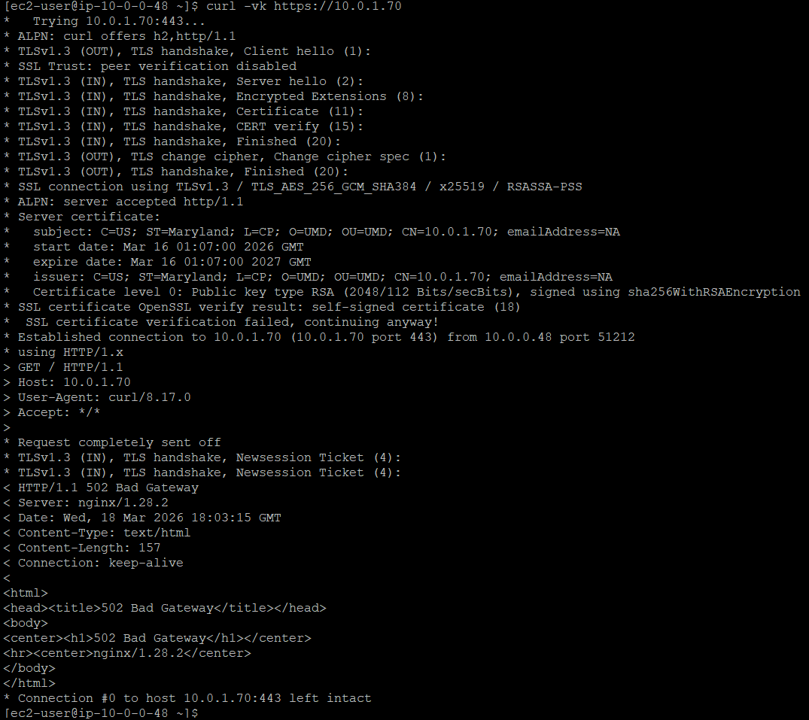
Final Outcome:
Screenshot showing the TLS
Handshake.

Slide 8
Final Outcome:
A basic front end web application was built, which comprises of a login page, which fetches the data from the RDS database instance to output to the WebApp.
This project is still a work in progress, as I am still working on the Active Directory Part, and MFA implementation. I am also still working on expanding the number of users and implementing the database schema for multiple users.

